Slide 1
Targeted Infection Prevention Program Study: The Infectious
Disease Process & Chain of Cross Transmission
Module # 2
Ruth Anne Rye, RN, BS, CIC;
Russ Olmsted, MPH, CIC
Notes:
Series of events that are necessary for the transmission of communicable diseases
Referred to as Chain of Infection
Each link must be present in logical sequence to produce disease
Introduce segments in the chain
We will look at each link individually

Slide 2
The Infectious
Disease Model
On Cross
Transmission
Of Microbes
[Germs]
Or…
How
Microbes
Move
around
Infectious
Agent
Reservoir
Risk Factors
For LTCF
Resident
Chain of
Infection
Exit
Entry
Transmission
LTCF = long term care facility
Notes:
The Chain of Infection helps to explain the infection process. Each link represents a component or element in the cycle, and must be present in sequential order for infection transmission to occur. Understanding the characteristics of each link and the relation to the other links is important to determine interventions and strategies to break the chain and prevent infection. Breaking the chain of infection is the responsibility of every healthcare professional.

Slide 3




Infectious Agent or Microbe
Chain of
Infection
Exogenous flora: from outside the body
  Example: bacteria = methicillin-resistant Staph. aureus [MRSA] is carried to the resident via hands of healthcare worker (HCW)
Endogenous flora: from inside or on the body
Bacteria
  Bacilli
  Cocci
  Spirochetes
Virus
Fungi
Rickettsia
Protozoa

Slide 4

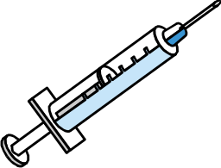
Reservoir
Chain of
Infection
➔ Place where microbe (germ) grows and reproduces
  Humans: Resident’s own microbial flora – transient (temporary) or resident (more permanent)
  other sources = healthcare workers, family, visitors
  - Animals; pet therapy program
  Environment: (food, beverages, soil, healthcare equipment)
    Contaminated
    Handling
    Storage

Slide 5

The Iceberg Effect: Much larger proportion of microbes are present but not causing infection
Infected
Colonized
Notes:
This iceberg graphically represents colonization versus infection. Those patients that are infected with an organism represent just the “tip of the iceberg” of patients that are colonized or infected.
Just because a patient is not infected, or showing signs of infection, does not mean that they do not carry organisms that could be transferred to another patient if proper hand hygiene and other infection control precautions are not taken.

Slide 6
Colonized or Infected:
What is the Difference?
Colonization: bacteria is present without evidence of infection (e.g. fever, increased white blood cell count)
Infection: active process where the bacteria is causing damage to cells or tissue;
  example purulent drainage from an open wound on the resident’s skin.
  UTI: resident has new fever and complains of burning pain when urinating plus frequency and urgency
If an infection develops, it is usually from bacteria that colonize patients, e.g. their endogenous microbial flora, but can also exogenous source, e.g. transmitted by hands of HCW
~ Bacteria can be transmitted even if the resident does not have active infection ~
Notes:
People who carry bacteria without evidence of infection are colonized.
If an infection develops, it is usually from bacteria that colonize patients.
Bacteria that colonize patients can be transmitted from one patient to another by the hands of healthcare workers.

Slide 7
Mode of Exit
Chain of
Infection
➔ Microbe leaves the Reservoir
  Respiratory tract
    Cough, sneeze, talking
  Gastrointestinal tract
    vomitus, feces
  Skin, mucous membranes
  Genitourinary tract
    Urine, semen, vaginal secretions
  Blood: from a cut through the skin or contaminated needle
  Artificial openings, e.g. tracheostomy or feeding tube inserted through the skin

Slide 8



Mode of Transmission
Chain of
Infection
Contact
  Direct
  Indirect
Droplet
Airborne
Other sources of infection
  Example: food-borne from contaminated food

Slide 9
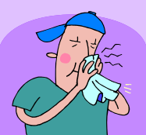


Mode of Entry
Chain of
Infection
➔Infectious agent enters the new host (resident or patient)
  Respiratory tract
    Breathing contaminated air droplets
  Gastrointestinal tract
    Eating, drinking, hand-to-mouth (fecal-oral route)
  Skin, mucous membranes
    Non-intact skin
    Hand-to-eye and nose
  Genitourinary tract
    Urinary catheter is present; bacteria move up catheter into the bladder
  Blood
    Contaminated lancet used for blood glucose

Slide 10
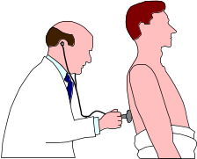


Resident Risk Factors : Increase risk for infection
Chain of
Infection
  Functionally dependent: resident needs lots of help with activities of daily living
  Immune system, e.g. does not work as well as one gets older
  Barrier compromised,
    fragile skin: tear, burn injury, chronic wound
    Device use: indwelling urinary catheter (Foley); feeding tube
  Additional factors:
    Admission to acute care hospital
    Antibiotic use

Slide 11
Breaking the Chain
Preventing Cross Transmission & Infection
Notes:
Series of events that are necessary for the transmission of communicable diseases
Referred to as Chain of Infection
Each link must be present in logical sequence to produce disease
Introduce segments in the chain
We will look at each link individually

Slide 12
Example: A Completed Chain of Cross Transmission & Infection
Infectious agent – methicillin-resistant Staphylococcus aureus (MRSA)
Reservoir - skin
Exit – open, draining wound on Resident A
Transmission – HCW picks up MRSA on hands & does not use hand hygiene before contact with Resident B
Entry – HCW contaminates indwelling urinary catheter tubing during manipulation of catheter… MRSA ascends to meatus and then into the bladder
Resident risk factor: indwelling urinary catheter
Infection: UTI develops in Resident B
Chain is complete – how can we break this chain?

Slide 13

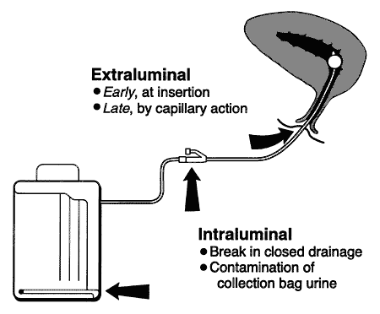
Infectious
Agent
Reservoir
Risk Factors
For LTCF
Resident
Chain of
Infection
Contain
drainage
From wound
Remove
Foley cath.
If possible
Exit
Entry
Transmission
Use hand hygiene
Notes:
The Chain of Infection helps to explain the infection process. Each link represents a component or element in the cycle, and must be present in sequential order for infection transmission to occur. Understanding the characteristics of each link and the relation to the other links is important to determine interventions and strategies to break the chain and prevent infection. Breaking the chain of infection is the responsibility of every healthcare professional.

Slide 14
Coming Attractions:
Standard Precautions & Hand Hygiene Next Module
Any Questions?

